Slide 1
Module 1 Networking Principles and layered architecture

Slide 2
Overview of Computer and Communication
Data Communications and Networking:
A Communications Model
Data Communications:
Evolution of network
Requirements
Applications
Network Topology (Line configuration, Data Flow),
Protocols and Standards, Network Models (OSI, TCP/IP)

Slide 3
ADDRESSED COURSE OUTCOMES
CO-1 Understand the principles of layered architecture, Internet protocol stack and the OSI model.

Slide 4
Data Communication
Exchange of data
Via Transmission medium
Characteristics:
Delivery
Accuracy and
Timeliness
Jitter

Slide 5
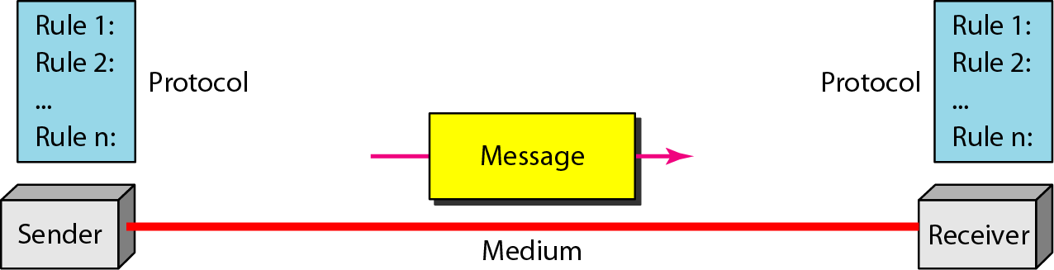
Components of Data Communication
Source: Data Communications and Networking – Behrouz A. Forouzan

Slide 6
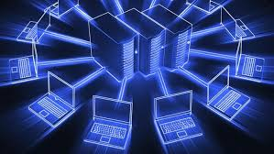
Networks
set of devices connected by communication links.
computer, printer, or any other device capable of sending and/or receiving data generated by other nodes on the network.
Network Criteria
Performance
Reliability
Security

Slide 7
Network Benefits: SHARING RESOURCES
Types of resources are:
1. Hardware: A network allows users to share many hardware devices such as printers, modems, fax machines, CD ROM, player, etc.
2. Software: sharing software resources reduces the cost of software installation, saves space on hard disk.

Slide 8
Characteristics of Network
Topology : The geometric arrangement of a computer system.
Protocol : The protocol defines a common set of rules and signals that computers on the network use to communicate. One of the most popular protocols for LANs is called Ethernet.
Architecture : Networks can be broadly classified as using either a peer to peer or client/server architecture.

Slide 9
Pros & Cons of Networks
Increased speed
Reduced cost
Improved security
Centralized software managements
Electronic mail
Flexible access
High cost of installation
Requires time for administration
Failure of server
Cable/Media faults

Slide 10
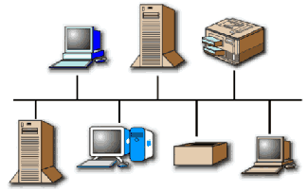
COMPUTER NETWORK
A computer network may be defined as an interconnected
collection of autonomous computers.
collection of computers, printers, routers, switches, and other devices that are able to communicate with each other over some transmission media.

Slide 11
COMPONENTS OF COMPUTER NETWORK
Two or more computers
Cables as links between the computers
A network interfacing card(NIC) on each computer
Switches
Software called operating system(OS)

Slide 12
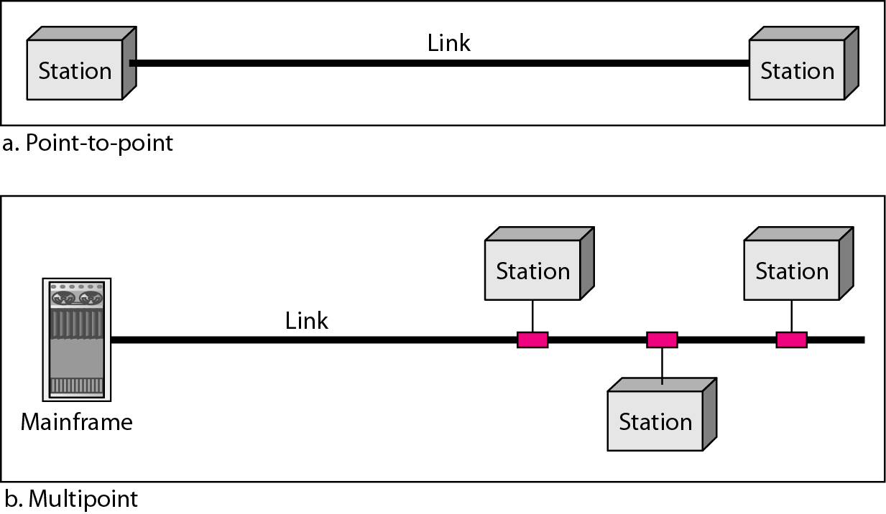
Line Configuration
Source: Data Communications and Networking – Behrouz A. Forouzan

Slide 13
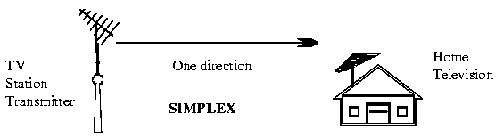
Data Flow
Simplex: Data flows in only one direction
E.g. Radio and Television broadcasts. They go from the TV station to your home television.

Slide 14

Data flow -Continued
Half duplex: Data flows in both directions but only one direction at a time on the data communication line.
Ex. Conversation on walkie-talkies

Slide 15

Data flow -Continued
Full duplex: Data flows in both directions simultaneously at the same time.
Ex. Phone communication

Slide 16
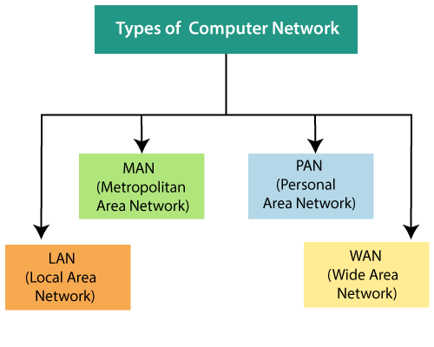
Network Categories

Slide 17
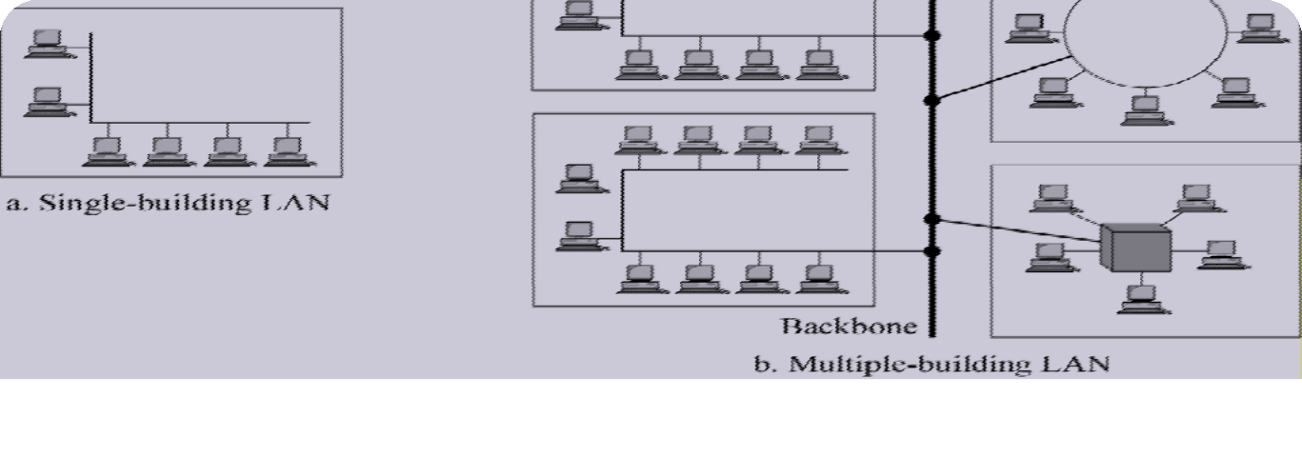

Local Area Network(LAN)
The network can be categorized based on its size, its ownership, the distance it covers, and its physical architecture
LAN : 10m – Room, 100m - Building and 1km or 2 km – Campus.

Slide 18
Local Area Network(LAN)
It covers a small geographical area with in a building or up to a few kilometers outside
They are widely used to connect PC with in a office.
LAN has distinguished from other networks by three characters.
size
their transmission technology
their Topology
LAN run at speeds of 10 Mbps to 100 Mbps. or (100/1000Mbps)
Different Topologies will be used for LAN Connectivity.
Bus / RING
IEEE 802.3 known as “Ethernet” - Example for LAN

Slide 19
Advantages of LAN
LAN provides a cost-effective multi-user computer environment.
A LAN is suited to any type of application.
Any number of users can be accommodated.
It is flexible and growth-oriented.
Today speeds are normally 100 or 1000 Mbps.
It provide data integrity.

Slide 20
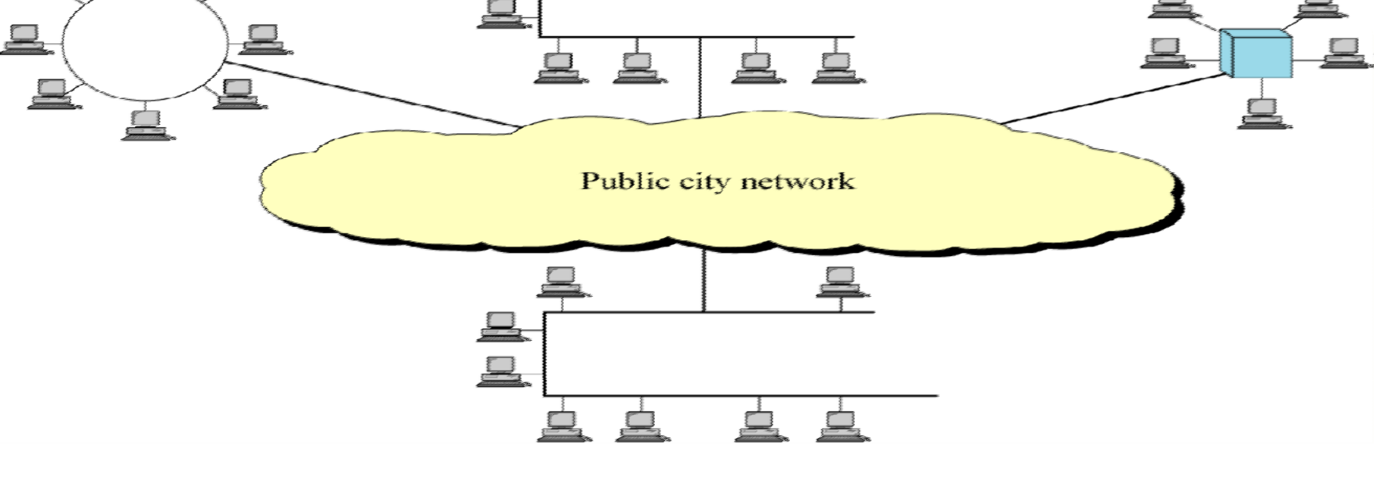
Metropolitan Area Network (MAN)
10km or 20 km – upto City level

Slide 21
Metropolitan Area Network (MAN)
MAN is a bigger network covers a group of nearby offices in a city up to 10 – 20 kilometers range.
MAN supports both voice and data.
The typical example is Local Cable Network.
MAN run at speeds of 150 Mbps.
Bus Topology is used for MAN Connectivity.
It may be a single network such as a cable TV network or it may be a means of connecting a number of LANs into a large network so that resources may be shared LAN-to-LAN as well as device-to- device.
The best-known example of a MAN is the cable television network available in many cities

Slide 22
Metropolitan Area Network (MAN)
MAN provides the transfer rates from 34 to 150 Mbps.
MAN is designed with two unidirectional buses.
Each Bus is independent of the other in the transfer of data.
The topology can be designed as an open bus or closed bus
configuration.
It supports both data and voice.
The high speed links between LANs within a MAN are made
possible by fiber-optic connection.

Slide 23
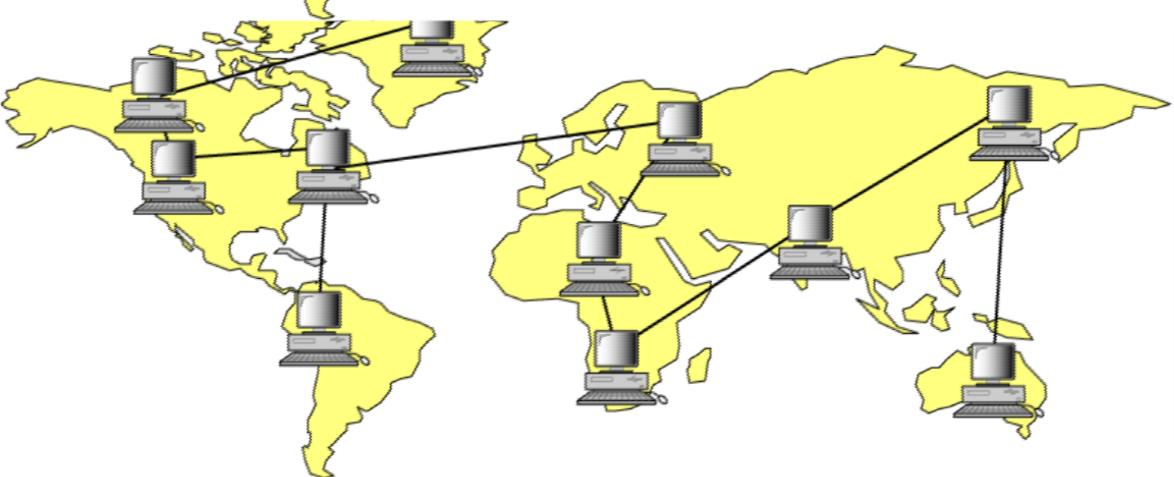
Wide Area Network (WAN)
A wide area network, or WAN, spans a large geographical area, often a country or continent (The Internet).

Slide 24
Wide Area Network (WAN)
Hosts / Subnet - The job of the Subnet is to carry the messages from host to host.
Transmission Lines
Switching Elements ( Specialized Systems )
Packet Switched Nodes / Router
Inside the Subnet routers have a connectivity among themselves.
Store and Forward Concept
All the Topologies are applicable
Works at 100 Mbps to 1000 Mbps.

Slide 25
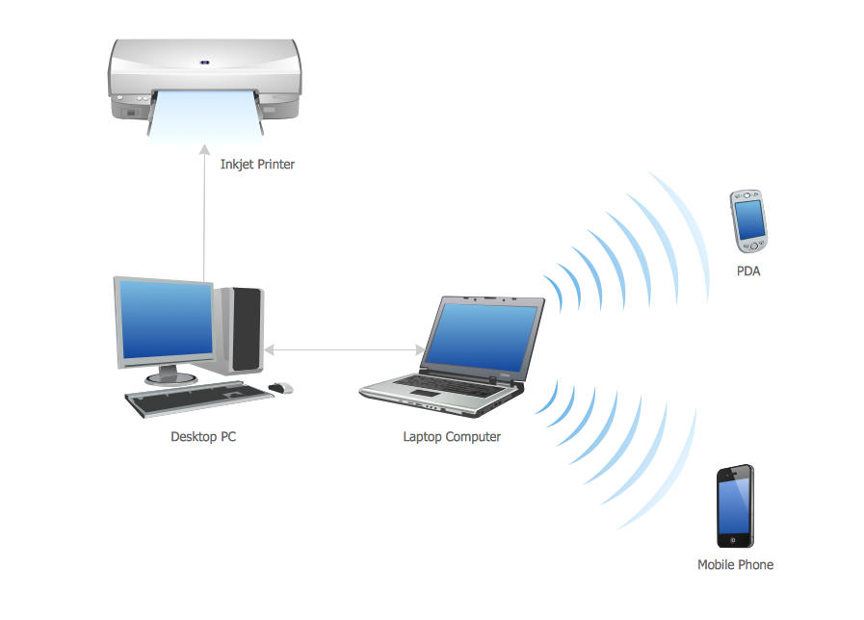
Personal Area Network
A personal area network, or PAN, is a computer network that enables communication between computer devices near a person.
Examples of wireless PAN, or WPAN, devices include cell phone headsets, wireless keyboards, wireless mice, printers, bar code scanners and game consoles

Slide 26

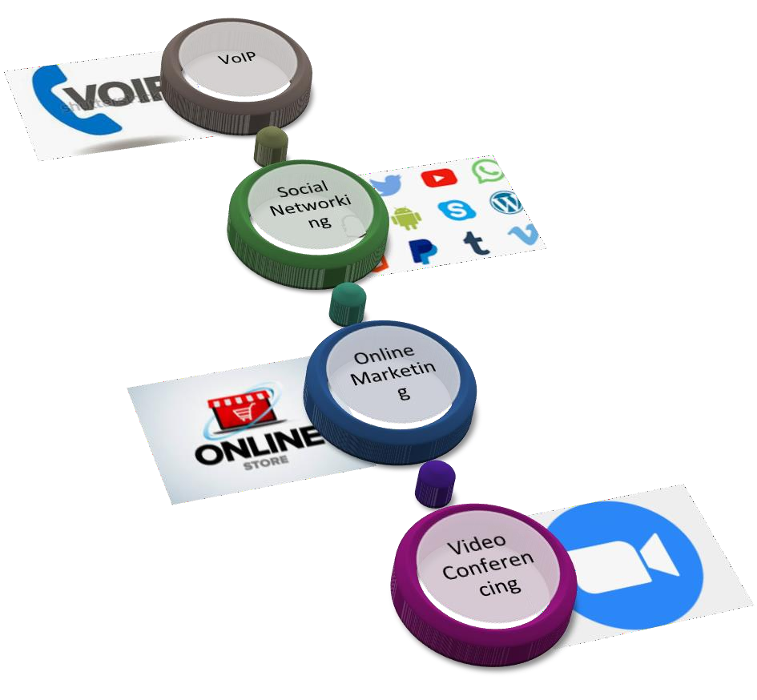
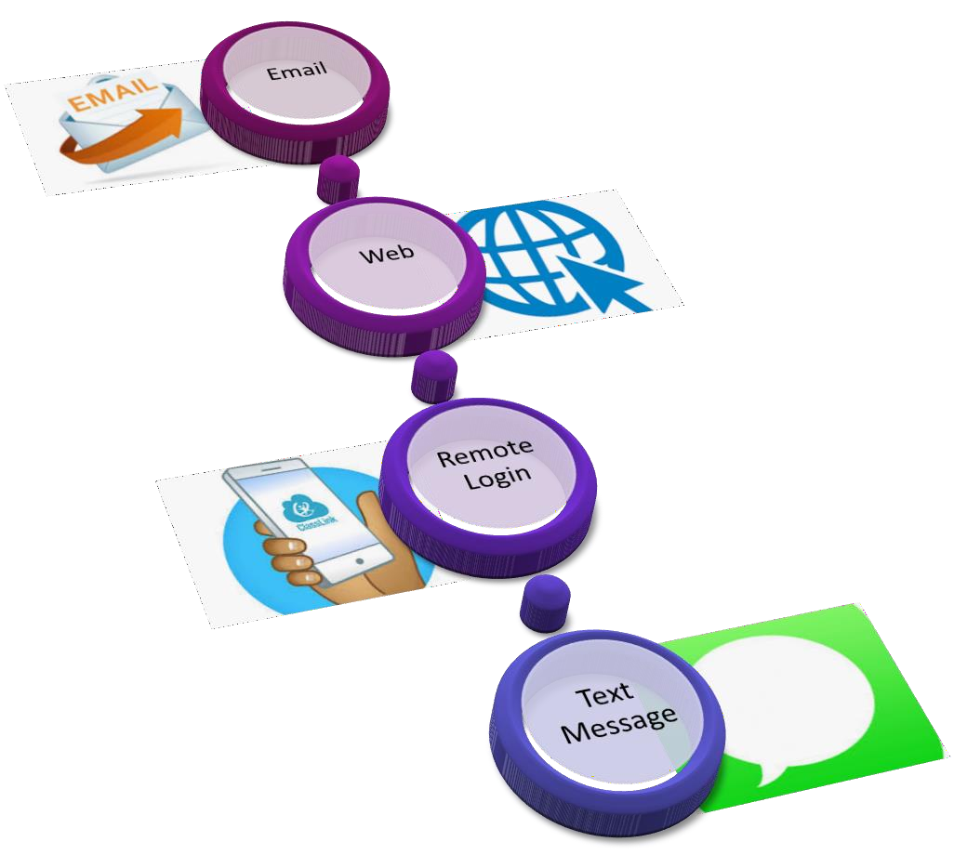
Applications of Networks

Slide 27
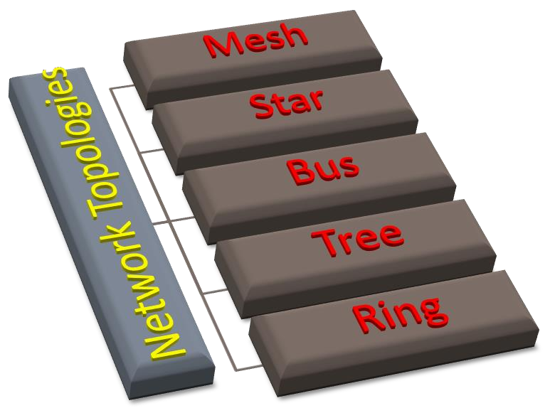
Network Topology
Physical layout of a network
The geometric representation of the relationship of all the links and linking devices (nodes) to one another.
Mesh
Star
Bus
Tree
Ring

Slide 28
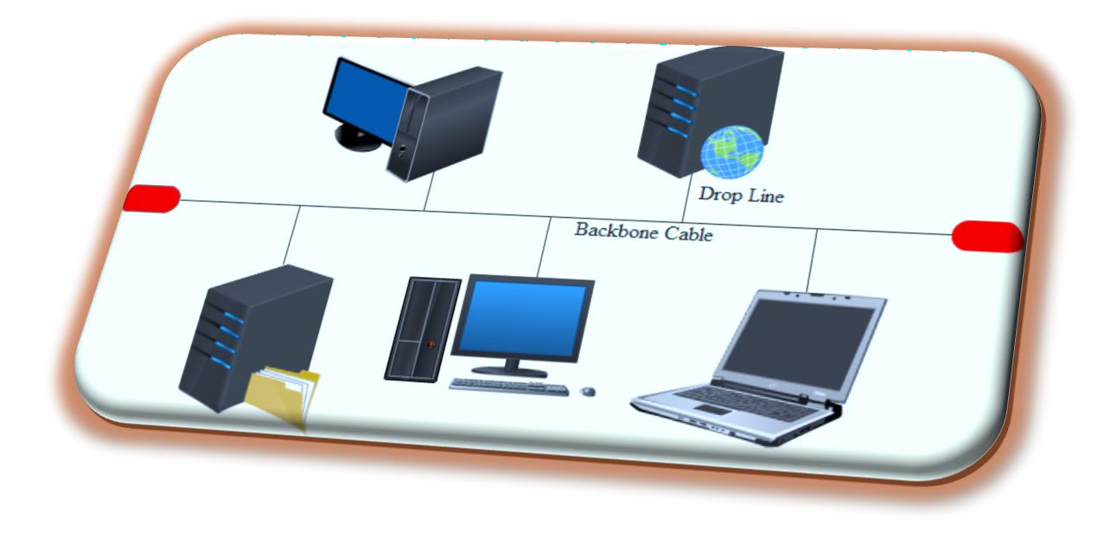
Bus Topology
All stations are attach directly to a linear transmission medium through
appropriate hardware interfacing known as a tap.
Backbone Cable
Data Flow - Full duplex
Terminator
Advantages
Ease of installation
Less cabling
Disadvantages
Difficult reconfiguration and fault isolation
Difficult to add new devices
If backbone cable fails, it can stops all transmission.

Slide 29
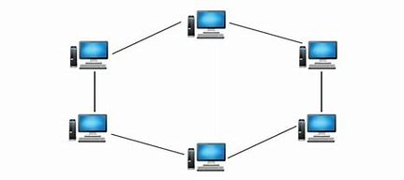
Ring Topology
Dedicated point-to-point connection
A signal is passed along the ring in one direction
Each device in the ring incorporates a repeater.
Advantages
Easy to install and reconfigure
Easy fault identification
Disadvantages
Unidirectional traffic
Network fails even if single link break exists

Slide 30
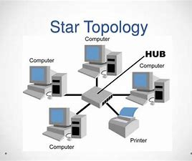
Star Topology
Central Controller - acts as an exchange
Two point to point links – Transmission/Reception
The devices are not directly linked to one another.
It does not allow direct traffic between devices.
Advantages
Less expensive and less cabling
Installation and configuration are easy
Robust and Easy fault identification
No disruptions
Disadvantages
Large Topology
Dependency

Slide 31
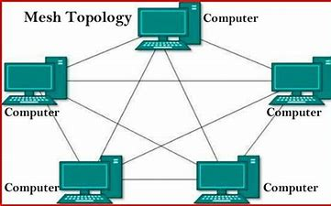
Mesh Topology
Every device has a dedicated point-to-point link to every other device
n(n-1)/2 physical channels to link n devices.
n-1 I/O ports.
Advantages
No traffic issues
Robust
Privacy and security.
Easy Fault identification and fault isolation
Disadvantages
Requires more number of cables and I/O ports
Wiring occupies more space
Hardware expensive

Slide 32
Tree Topology
It integrates the characteristics of Star & Bus Topology.
In Tree Topology, the number of Star networks is connected using Bus.
This main cable seems like a main stem of a tree, and other star networks as the branches.
It is also called Expanded Star Topology.
Advantages :
Failure of one node never affects the rest of the network.
Node expansion is fast and easy.
Dis-Advantages :
It is heavily cabled topology
If the hub or concentrator fails, attached nodes are also disabled.

Slide 33
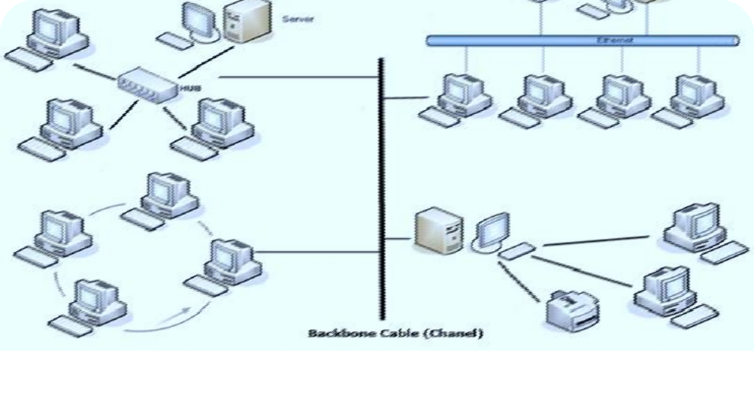
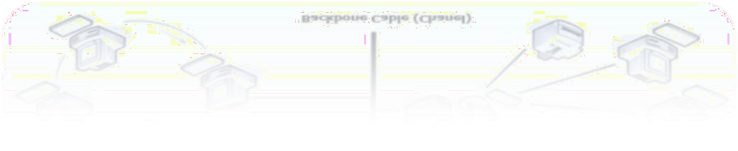
Hybrid Topology
A network which contain all type of physical structure and connected under a single backbone channel.

Slide 34
Applications of Network Topology
Mesh Topology
Telephone Regional office.
Wide Area Network – WAN
Star Topology
Star topology used in Local Area Networks(LANs).
High speed LAN often uses STAR.
Bus Topology
Most computer motherboard.
Ring Topology
Ring topologies are found in some office buildings or school
campuses.
Today high speed LANs made this topology less popu^{Dr}l.a^{Ka}r^{r}.^{mel A, VIT Chennai}

Slide 35
Considerations for choosing topology
Money
Bus n/w may be the least expensive way to install a n/w.
Length-of cable needed
The linear bus n/w uses shorter lengths of cable.
Future growth
With star topology, expending a n/w is easily done by adding another devices.
Cable type
Most common used cable in commercial organization is twisted pair which often used with star topologies.

Slide 36

Practice Question 1
Design a hybrid topology with a star backbone and four ring networks.
Design a hybrid topology with a ring backbone and three bus networks.
For n devices in a network, compute the number of cable links
required for the topologies,
Mesh
Ring
Bus
Star

Slide 37
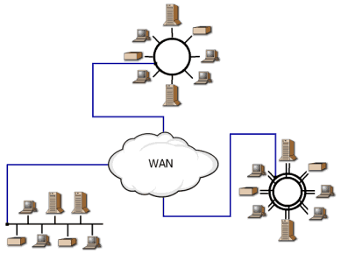
Internetwork
An Internetwork is a collection of independent remote networks, LANs and WANs, and their connecting devices. They function together as one large network sharing connectivity resources.

Slide 38
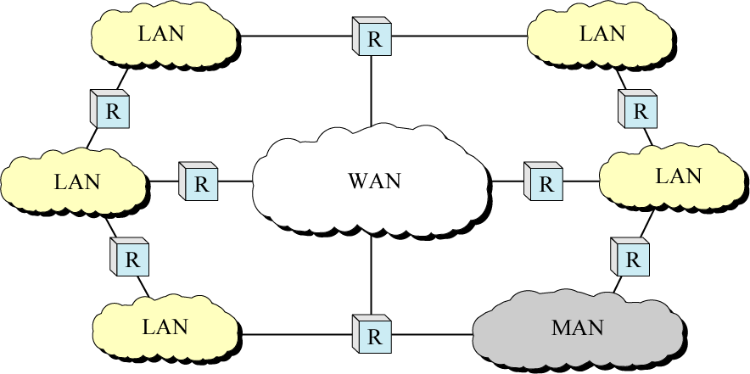
Internetwork (Internet)

Slide 39
The Internet
A global computer network providing a variety of information and communication facilities, consisting of interconnected networks using standardized communication protocols
History of Internet
ISPs

Slide 40
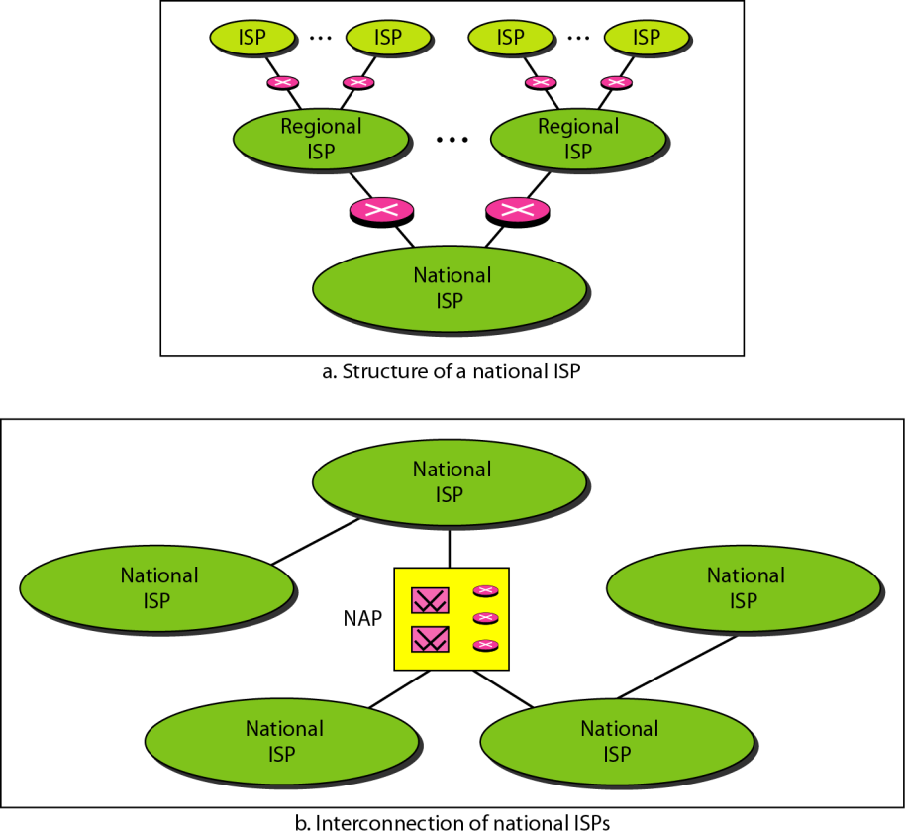
Hierarchical Organization of Internet

